Slide 1

Algo- trading project

Slide 2
Platform
Blueshift is an online platform that assists in coding trading strategies and algorithms using blocks or Python code. It provides a user-friendly interface that allows traders and developers to easily create and test their strategies.
With Blueshift, users can leverage the power of Python to implement complex trading logic and algorithms. Whether you are a beginner or an experienced trader, Blueshift offers a wide range of features and tools to help you optimize your trading strategies. From backtesting to live trading, Blueshift has got you covered.

Slide 3

Principle
In this strategy we used to monitor two indicators of the particular stock, those are:-
Short-term Moving Average (50 - MA)
Long-term Moving Average ( 200 – MA)
When the Short-term moving average crosses over the long-term moving average this position is called the GOLDEN CROSS. At this place, the golden cross indicates the bullish nature of the market, so taking a long position where the golden cross occurs.
When the Long-term moving average crosses over the Short-term moving average this position is called the DEATH CROSS. At this place the golden cross indicates the bearish nature of the market, so taking a short position where the Death cross occurs.
The model takes a long position at the GOLDEN CROSS and square-offs the position at the DEATH CROSS to avoid the loss and maximize the profit optimally. Similarly, it takes a short position at the DEATH CROSS and square-offs at GOLDEN CROSS to gain the profit
Strategy applied: Golden crossover

Slide 4
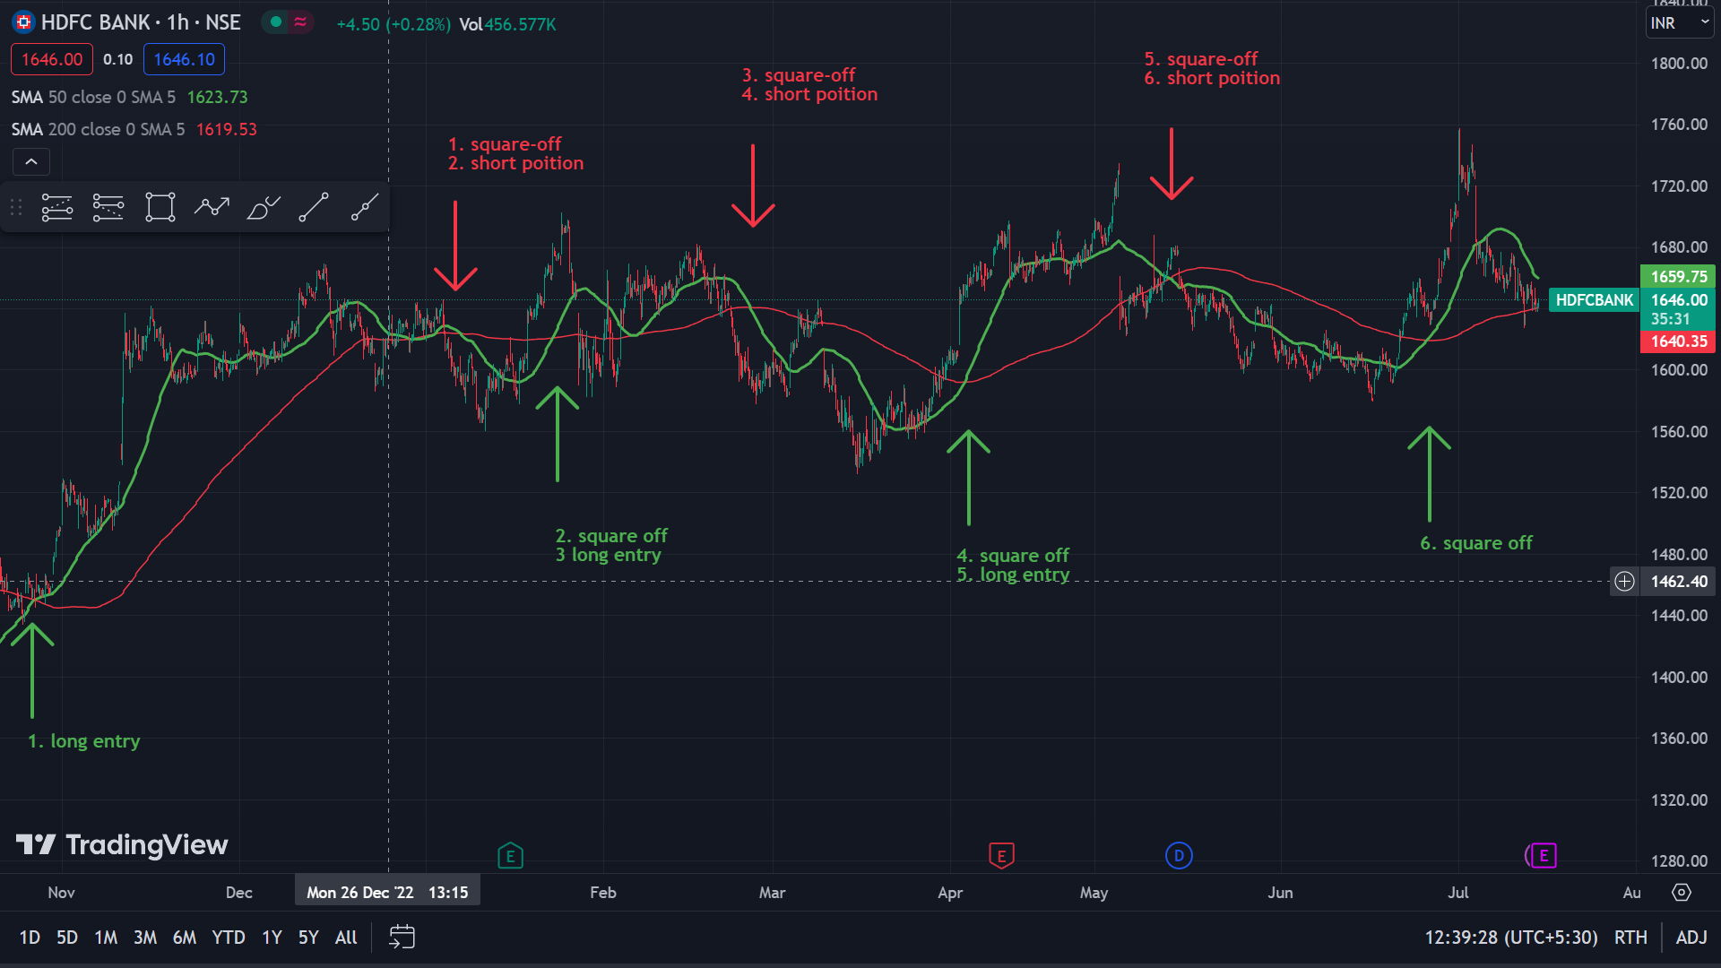
GRAPH

Slide 5
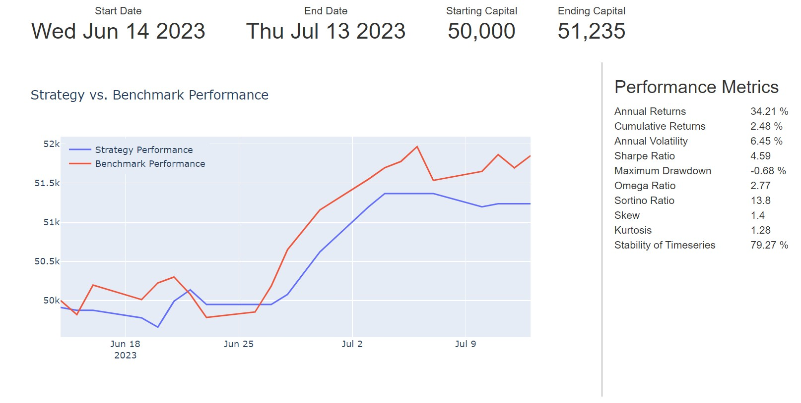
PERFORMANCE REPORT

Slide 6

Thank You
~RUDHIR CHANDRA MAHALIK

